Slide 1

String Matching Algorithms
COURSE: DESIGN AND ANALYSIS OF ALGORITHMS
From Sequential Search to Rabin–Karp
Sequential Search | String Matching | Brute-Force Matching | Hashing | Rabin–Karp Algorithm

Slide 2




What Is Searching?
PART 1: INTRODUCTION
Searching is the process of finding a required item, called a target, within a collection of data. It is one of the most fundamental operations
performed by computers.
Attendance
Finding a student's name in an attendance list.
Class Record
Finding a roll number in a class record.
Product Search
Finding a product in a list of products.
Document
Finding a particular word in a document.
Different searching algorithms use different strategies depending on the type of data and the problem. The simplest searching strategy is to
start from the beginning and check items one by one. This technique is called Sequential Search.

Slide 3
Sequential Search (Linear Search)
PART 2: SEQUENTIAL SEARCH
Sequential Search, also known as Linear Search, is a simple searching technique in which elements are checked one after another in a sequence until the desired element is found or the entire collection has been checked.
Key Characteristics
Elements are checked one by one.
Searching starts from the first element.
The search stops immediately when the target is found.
If the target is not present, all elements are checked.
The data does not need to be sorted.
Example
List: [10, 25, 8, 40, 15]
Target: 40
10 → 25 → 8 → 40 ✓
The algorithm stops after finding 40. The element 15 is never checked.

Slide 4
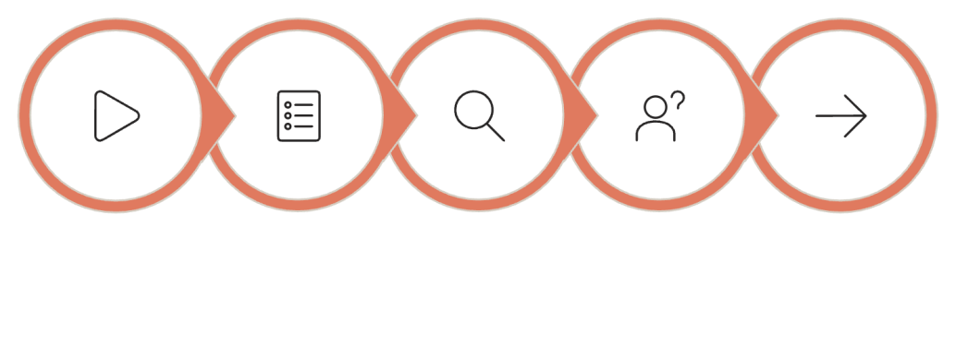
How Does Sequential Search Work?
Step-by-Step Process Flowchart
1
Start
Begin with the first element of the list.
2
Compare
Compare the current element with the target.
Start
Select Element
Compare
Found?
Move Next
3
Found?
If equal to the target, report that the target is found.
4
Continue
If not equal, move to the next element.
5
Repeat
Continue until the target is found or the end of the list is reached.
6
Not Found
If the end is reached without a match, report the target is not found.

Slide 5

Sequential Search — Example 1: Searching for a Number
List = [12, 25, 7, 40, 18]
Target = 40
Comparison | Current Element | Comparison | Result
1 | 12 | 12 ≠ 40 | Continue
2 | 25 | 25 ≠ 40 | Continue
3 | 7 | 7 ≠ 40 | Continue
4 | 40 | 40 = 40 | Found ✓
The target 40 is found after 4 comparisons. The algorithm does not need to check 18 because the search stops immediately after finding the
target.

Slide 6
Sequential Search — Example 2: Searching for a Student
List: [Aman, Simran, Rohit, Rahul, Neha] Target: Rahul
A teacher wants to find Rahul in a line or list of students. The teacher checks each student one by one.
Aman
Not Rahul → Continue
Simran
Not Rahul → Continue
Rohit
Not Rahul → Continue
Rahul ✓
Found! Search stops here.
This is Sequential Search because the teacher checks students sequentially and stops when the required student is found.

Slide 7
Sequential Search — Example 3: Searching for a Book
Target: Algorithms
01 02 03
Mathematics
Not the required book. → Continue.
Physics
Not the required book. → Continue.
Chemistry
Not the required book. → Continue.
04
05
Algorithms ✓
Found! The search stops here.
English
Never checked — the search already ended.
When the exact position of the book is unknown, a person may check books one by one. This is a real-life example of Sequential Search.

Slide 8
Sequential Search — Example 4: Element Not Found
List = [5, 10, 15, 20, 25]
Target = 30
5
5 ≠ 30 → Continue
10
10 ≠ 30 → Continue
15
15 ≠ 30 → Continue
20
20 ≠ 30 → Continue
25
25 ≠ 30 → End of List
Element 30 is not found.
All elements have been checked. This represents a worst-case situation because the algorithm must examine the entire list before concluding
that the target does not exist.

Slide 9
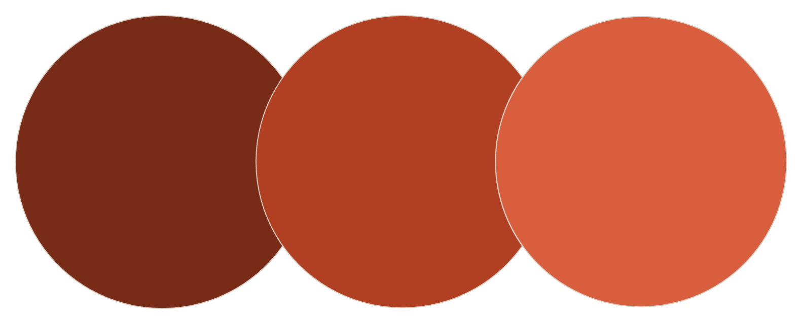
Sequential Search — Complexity Analysis
Best Case — O(1)
Target found at the very first position. Example: [40, 10, 20, 30], Target = 40. Only one comparison is needed.
Worst Case — O(n)
Target is at the last position or is not present at all. The algorithm must check every element in the list.
Average Case — O(n)
On average, the target may be found somewhere in the middle, requiring approximately n/2 comparisons, which simplifies to O(n).
Space Complexity — O(1)
Only a few additional variables are used (index, comparison counter). No additional data structures required.
Position 1
1 comparison — Best
Position n/2
n/2 comparisons — Average
Position n or absent
n comparisons — Worst

Slide 10




From Element Searching to String Searching
PART 3: STRING MATCHING
Sequential Search is used to search for a single element. However, many real-world problems require us to search for a sequence of
characters rather than a single element.
Word in a Book
Searching for the word Algorithm in a textbook or reference material.
Keyword in PDF
Searching for a keyword in a PDF document or digital report.
Name in File
Searching for a student's name in a text file or database
export.
DNA Sequence
Searching for a DNA pattern in biological data — a critical
application.
This process of searching for a sequence of characters is called String Matching or Pattern Matching.

Slide 11
What Is String Matching?
String Matching is the process of finding whether a sequence of characters, called a pattern, occurs within another sequence of characters, called a text.
Formal Example
Text: DATA STRUCTURES AND ALGORITHMS
Pattern: ALGORITHM
More Examples
Example 1
Text: COMPUTER SCIENCE
Pattern: SCIENCE
→ Found once
Example 2
Text: BANANA
Pattern: ANA
→ Found twice (indices 1 and
3)
The algorithm examines the text and tries to determine whether the sequence of characters in the pattern occurs inside the text. A match occurs only when all corresponding characters match.
Three Possible Outcomes
Example 3
Text: HELLO WORLD
Pattern: DATA
→ Not found
Pattern found once.
Pattern found multiple times.
Pattern not found at all.

Slide 12





Why Is String Matching Important?
Search Engines
Search engines search for keywords in large collections of web pages and documents to return relevant results.
Text Editors
The Find option searches for words or phrases inside a document. Ctrl+F is powered by string-matching algorithms.
Spell Checking
Applications compare words with dictionary entries to detect and correct spelling mistakes.
Bioinformatics
Scientists search for patterns in DNA and protein sequences to identify genes and study diseases.
Cybersecurity
Security systems search files or network data for suspicious or malicious patterns to detect threats.
Efficient string matching becomes critically important when the text is very large — searching through millions of web pages or billions of base pairs of DNA.

Slide 13
Text and Pattern — Core Concepts
Examples
Text (T)
Example 1:
The larger sequence of characters in which searching is performed. It is the "haystack" we search through.
Text: COMPUTER SCIENCE
Pattern: SCIENCE
→ Pattern occurs once.
Pattern (P)
The smaller sequence of characters that we want to find inside the text. It is the "needle" we are looking for.
Example 2:
Text: BANANA
Pattern: ANA
→ Pattern occurs at positions 1 and 3.
Possible Outcomes
Example 3:
Text: HELLO WORLD
Pattern: DATA
→ Pattern does not occur.
Pattern can occur once.
Pattern can occur multiple times (overlapping or non-
overlapping).
Pattern can not occur at all.

Slide 14
How Does String Matching Work?
1
Select Position
Select a possible starting position in the text.
2
Compare Characters
Compare the pattern with the corresponding characters in the
text one by one.
3
Match Found
If all characters match, report a successful match at the current position.
4
Mismatch
If a mismatch occurs, continue searching according to the strategy of the algorithm.
Different algorithms use different strategies after a mismatch. This presentation focuses on:
1 2
3
Brute-Force
Try every possible position.
Hashing
Use numerical fingerprints to filter.
Rabin–Karp
Rolling hash with verification.
Other advanced algorithms (such as Knuth–Morris–Pratt) are covered in subsequent topics.

Slide 15
What Is Brute-Force String Matching?
PART 4: BRUTE-FORCE STRING MATCHING
Brute-Force String Matching is a technique that attempts to match a pattern with a text at every possible starting position using direct character-by-character comparison.
Complete Process
01
Key Emphasis
The algorithm does not use any advanced shortcut. It systematically tries every possible position in the text.
The number of possible starting positions for a text of length n and pattern of length m is:
n − m + 1
This is the number of positions the outer loop will check.
Align
Align the pattern with the first possible position in the text.
02
Compare
Compare characters one by one from left to right.
03
Match?
If all characters match, report a successful match.
04
Mismatch
If a mismatch occurs, shift the pattern one position to the right.
05
Repeat
Start comparing again from the beginning of the pattern.
06
Finish
Continue until the pattern is found or all positions are exhausted.

Slide 16
Brute-Force Example 1: Searching "DATA"
Text: COMPUTER DATA STRUCTURES Pattern: DATA
The algorithm initially tries to match DATA at the beginning of the text. At positions where the first character does not match D, it moves
forward quickly after the first comparison.
C O M P U T E R ...
C ≠ D → Shift immediately. Continue checking positions where D might appear.
Window at "DATA"
D = D ✓ A = A ✓ T = T ✓ A = A ✓
All characters match!
Result: The pattern DATA is found. All four characters match consecutively.

Slide 17
Brute-Force Example 2: Searching "ANA" in "BANANA"
Text: BANANA
Pattern: ANA
Position | Window | Comparison | Result
0 | BAN | B ≠ A | No Match
1 | ANA | A=A ✓, N=N ✓, A=A ✓ | Match at Index 1 ✓
2 | NAN | N ≠ A | No Match
3 | ANA | A=A ✓, N=N ✓, A=A ✓ | Match at Index 3 ✓
This example demonstrates that a pattern can occur more than once in the same text. Brute-Force String Matching continues scanning after the first match to find all occurrences. Pattern ANA is found at positions [1, 3].

Slide 18
Brute-Force Example 3: Searching "CAT"
Text: THE CAT IS SLEEPING
Pattern: CAT
01
02
Position 0: "THE"
T ≠ C → Mismatch on first character. Shift right.
Position 1: "HE "
H ≠ C → Mismatch. Shift right.
03
04
Position 2: "E C"
E ≠ C → Mismatch. Shift right.
Position 4: "CAT"
C = C ✓, A = A ✓, T = T ✓
All characters match!
The word CAT is found at index 4.
This is similar to searching for a specific word inside a text document. The algorithm scans position by position and stops as soon as a full match
is confirmed.

Slide 19
Brute-Force Example 4: Pattern Not Found
Text: HELLO WORLD
Pattern: DATA
Position | Window | First Char Match? | Outcome
0 | HELL | H ≠ D | No Match
1 | ELLO | E ≠ D | No Match
2 | LLO | L ≠ D | No Match
3 | LO W | L ≠ D | No Match
4–7 | ... | None match D | No Match
Pattern DATA is not found in the text.
The algorithm checks every possible starting position. This represents a worst-case situation because the algorithm may need to examine all possible positions — none of which yield a match.

Slide 20

Searching a Word in a Text Document
Document (Text)
Real-World Applications
Searching keywords in notes and study material.
Design and Analysis of Algorithms is an important subject. Algorithms are used to solve computational problems.
Searching names in student record documents.
Pattern: Algorithms
Finding specific terms in reports and papers.
Building simple document-searching and indexing tools.
Complete Practical Process
01
Begin
Start at the beginning of the document text.
02
Scan
Examine possible positions where the word may begin (where the character 'A' appears).
03
Compare
Compare the characters of the pattern with the characters of the document at that position.
04
Match
When all characters of Algorithms match consecutively, report a successful match.
05
Continue
Continue searching if multiple occurrences are required. Here "Algorithms" appears twice.

Slide 21
Python Implementation of Brute-Force String Matching
def brute_force_search(text, pattern): comparisons = 0
for i in range(len(text) - len(pattern) + 1): found = True
for j in range(len(pattern)): comparisons += 1
if text[i + j] != pattern[j]: found = False
break
if found:
return i, comparisons return -1, comparisons
text = "COMPUTER DATA STRUCTURES"
pattern = "DATA"
position, comparisons = brute_force_search(text, pattern) if position != -1:
print("Pattern found at index:", position) else:
print("Pattern not found")
print("Total comparisons:", comparisons)
Expected Output:
Pattern found at index: 9 Total comparisons: 13

Slide 22





Brute-Force — Code Explanation and Dry Run
Key Code Sections Explained
Visual Dry Run — Text: "COMPUTER DATA STRUCTURES", Pattern:
"DATA"
Outer Loop
Inner Loop
i | Window | Comparison | Result
0 | COMP | C ≠ D | No Match
1 | OMPU | O ≠ D | No Match
... | ... | ... | No Match
9 | DATA | D=D✓ A=A✓ T=T✓ A=A✓ | Match ✓
for i in range(len(text) -
for j in range(len(pattern))
len(pattern) + 1)
Compares each character of the pattern with the corresponding text character.
Selects every possible starting
position. Range = n − m + 1.
Counter
Mismatch
comparisons += 1
if text[i + j] != pattern[j]:
Counts every character comparison made by the algorithm.
break
Stops the inner loop immediately on mismatch; shifts to the next outer position.
Match
If
found
remains
True
after the
inner loop, all characters matched
— return the starting index.

Slide 23




Advantages of Brute-Force String Matching
Easy to Understand
The algorithm follows a simple comparison process. Any beginner can follow and reason about its correctness.
Easy to Implement
Only loops and character comparisons are required. No complex data structures or preprocessing steps are needed.
No Complex Preprocessing
The pattern does not need special preprocessing before the search begins, unlike KMP .
Suitable for Small Inputs
For small texts and patterns, the simple approach is sufficient and perfectly acceptable.
It provides an important foundation for understanding more advanced string-matching algorithms. Without understanding brute force, the motivation for hashing and KMP is not clear.

Slide 24


Limitations and Disadvantages of Brute Force
Repeated Comparisons
The same characters may be compared repeatedly across different windows. Information from a previous mismatch is completely discarded.
Slow for Large Documents
Checking many possible positions in a large text becomes expensive. For a 1,000,000-character text and a 100-character pattern, up to 100,000,000 comparisons may be needed in the worst case.
Worst-Case Time Complexity
If n = length of the text and m = length of the pattern, the worst-case time complexity is O(n × m). This occurs when mismatches happen only at the last character of the pattern repeatedly.
No Intelligent Skipping
After a mismatch, the basic brute-force method simply shifts by one and tries again — even when it could logically skip multiple positions.
Can we use additional information to quickly reject positions that cannot possibly match? → This question introduces the concept of
Hashing.

Slide 25
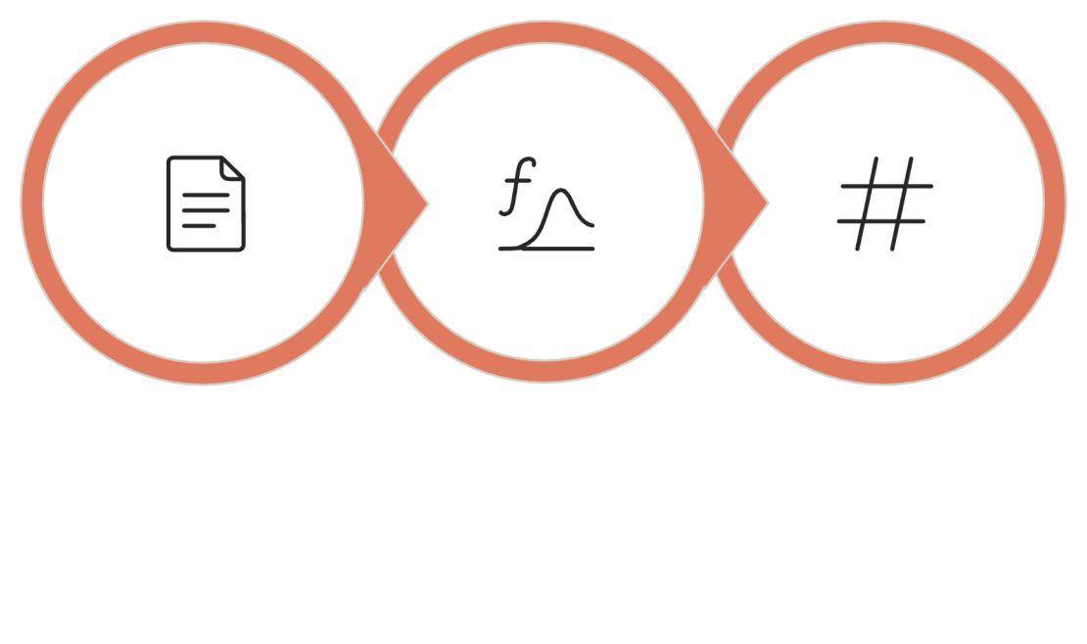

What Is Hashing?
PART 5: INTRODUCTION TO HASHING
Hashing is a technique that converts data into a numerical value called a hash value using a hash function.
Key Properties
Converts string data to a
number efficiently.
Equal strings always produce equal hash values.
Different strings usually produce different hash values.
Occasionally, different strings may produce the same hash value — this is called a hash collision.
String Input
Hash Function
Numerical Hash
Important Clarification: Because collisions are possible, equal hash values may sometimes occur for different strings. Therefore, character-by-character verification may still be required after a hash match.
A hash value acts like a numerical fingerprint or signature of data. Two identical strings always produce the same hash value for a deterministic hash function.

Slide 26
How Is Hashing Used in String Matching?
Suppose we have a pattern and a text window of the same length. Instead of comparing all characters immediately:
01 02 03
Pattern Hash
Calculate the hash value of the pattern once, before searching begins.
Window Hash
Calculate the hash value of the current text window (same length as the pattern).
Compare Hashes
Compare the two hash values — a fast numerical comparison.
04
05
Different Hash
Hash values differ → Strings cannot be equal → Reject the current
position immediately.
Same Hash
Hash values are equal → Strings may match → Verify actual characters
to confirm.
Hash Values Different
↓
Definitely Not a Match
Skip to next window.
Hash Values Same
↓
Possible Match
Compare Actual Characters
↓ Confirm Match or Collision

Slide 27
Hashing Example 1: Searching "CAT"
Text: DOG CAT RAT Pattern: CAT (length = 3)
The algorithm examines text windows containing three characters:
Window | Text | Hash Match? | Action
0 | DOG | No | Reject → Move
1 | OG | No | Reject → Move
2 | G C | No | Reject → Move
3 | CA | No | Reject → Move
4 | CAT | Yes | Verify → C=C✓ A=A✓ T=T✓ → Match ✓
Result: CAT is found. Most different windows are rejected through hash comparison before any character-by-character work is done.

Slide 28
Hashing Example 2: Searching "DATA"
Text: BIG DATA ANALYSIS Pattern: DATA (length = 4)
The algorithm examines four-character windows across the text:
BIG → "BIG "
Hash of "BIG " ≠ Hash of "DATA" Reject immediately — move forward.
→ "IG D"
Hash ≠ Pattern Hash Reject — move forward.
→ "DATA"
Hash of "DATA" = Hash of "DATA" ✓ Verify: D=D✓ A=A✓ T=T✓ A=A✓ Pattern found!
Hashing reduces unnecessary detailed comparisons for windows that are clearly different. Only when a hash match occurs do we invest time in character-by-character verification.

Slide 29

Hashing Example 3: Searching "ABC"
Text: XYZABCXYZ Pattern: ABC (length = 3)
XYZ
Hash ≠ ABC Hash Reject
YZA
Hash ≠ ABC Hash Reject
ZAB
Hash ≠ ABC Hash Reject
ABC
Hash = ABC Hash ✓
Verify → Match!
BCX
Hash ≠ ABC Hash
Reject
Hashing acts as a filter. Windows with clearly different hash values can be rejected before performing complete character-by-character comparison. Only candidate windows undergo full verification.

Slide 30
Basic Python Implementation of Hash-Based Matching
def simple_hash_search(text, pattern): pattern_hash = hash(pattern) pattern_length = len(pattern)
for i in range(len(text) - pattern_length + 1): window = text[i:i + pattern_length]
# Compare hash values first
if hash(window) == pattern_hash: # Verify the actual strings if window == pattern:
return i
return -1
text = "BIG DATA ANALYSIS"
pattern = "DATA"
position = simple_hash_search(text, pattern) if position != -1:
print("Pattern found at index:", position) else:
print("Pattern not found")
Expected Output:
Pattern found at index: 4

Slide 31


Explanation of Basic Hash-Based Implementation
pattern_hash = hash(pattern)
window = text[i:i + pattern_length]
Calculates the hash for the pattern once before the loop. This is efficient — we only compute it one time.
Extracts a substring from the text having the same length as the pattern. This is the current window being examined.
if hash(window) == pattern_hash
if window == pattern
Compares the hash of the window with the hash of the pattern. If different — skip immediately. If same — proceed to verify.
Verifies the actual strings. Necessary because hash collisions (different strings with same hash) are possible.
Important Note: This program demonstrates the concept of hash-based string matching. The Rabin–Karp algorithm uses a controlled
hash function and rolling hash technique rather than simply relying on Python's built-in
not support efficient incremental updates.
hash()
function. The built-in function does

Slide 32




What Is the Rabin–Karp Algorithm?
PART 6: RABIN–KARP ALGORITHM
Rabin–Karp is a pattern-matching algorithm that uses hashing to compare the pattern with substrings of the text, followed by character verification when hash values match.
Hashing-Based
Compares numerical hash values before detailed character comparison to filter non-matching windows.
Sliding Window
A window of the same length as the pattern slides through the text one position at a time.
Rolling Hash
Uses rolling hash techniques to update hash values efficiently as the window moves — no full recalculation.
Verification
When hash values match, the algorithm verifies actual characters to handle possible collisions.

Slide 33





Why Do We Use Rabin–Karp?
Quick Comparison
Hash values can quickly reject many windows that do not match, avoiding expensive character-by-character work for clearly different windows.
Reduced Unnecessary Comparisons
Detailed character comparison is mainly performed only when hash values match — a relatively rare event for good hash functions.
Rolling Hash
The hash can be updated incrementally as the window moves — removing the old character and adding the new one — instead of recalculating everything.
Multiple Occurrences
The algorithm naturally continues scanning after the first match and can identify every occurrence of the pattern in the text.
Rabin–Karp is introduced because brute-force matching may perform many unnecessary comparisons. Hashing provides an efficient
preliminary test.

Slide 34
Rabin–Karp Example 1: Searching "DATA"
Text: COMPUTER DATA STRUCTURES
01
Pattern: DATA
02
Compute Pattern Hash
Calculate the hash value of the pattern DATA once.
03
Compare Hashes
"COMP" hash ≠ "DATA" hash → Move the window forward.
First Window Hash
Take the first text window of length 4: "COMP". Calculate its hash.
Update Hash (Rolling)
Remove "C", shift remaining, add new character — efficient incremental update.
Hash Match Found
"DATA" hash = Pattern hash → Verify: D=D✓ A=A✓ T=T✓ A=A✓ →
Pattern Found!
04
05
Continue Sliding
Continue until the window becomes "DATA".
06

Slide 35
Rabin–Karp Example 2: "ANA" in "BANANA"
Text: BANANA
Pattern: ANA (length = 3)
Window | Text Window | Hash Match? | Verification | Result
0 | BAN | No | Not Required | No Match
1 | ANA | Yes | A=A✓ N=N✓ A=A✓ | Match at Index 1 ✓
2 | NAN | No | Not Required | No Match
3 | ANA | Yes | A=A✓ N=N✓ A=A✓ | Match at Index 3 ✓
The pattern ANA occurs twice: at index 1 and index 3. Pattern found at positions: [1, 3].
Rabin–Karp continues scanning after the first match to find all occurrences of the pattern in the text.

Slide 36

Rabin–Karp Example 3: Searching a Word in a Document
Text: ALGORITHMS ARE IMPORTANT IN COMPUTER SCIENCE Pattern: COMPUTER
How the Algorithm Proceeds
A window of length 8 (= len("COMPUTER")) slides through the text.
Connection to Real World
This is exactly how searching for a word inside a large text document works. When you press Ctrl+F and type "COMPUTER", the search algorithm slides through the document text, using efficient comparison techniques to quickly locate the word — even in a very large file.
"ALGORITH" → Hash ≠ Pattern Hash → Reject quickly.
"LGORITHM" → Hash ≠ Pattern Hash → Reject quickly.
Most windows rejected via hash comparison — no full character work needed.
"COMPUTER" → Hash = Pattern Hash → Verify characters.
C=C✓ O=O✓ M=M✓ P=P✓ U=U✓ T=T✓ E=E✓ R=R✓ → Pattern Found!

Slide 37
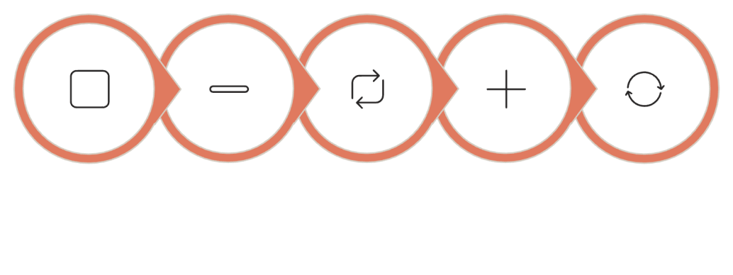
What Is a Rolling Hash?
The Problem Without Rolling Hash
Suppose the current window is ABCD and the next window is BCDE.
A naive approach would recalculate the entire hash of BCDE from scratch — redundant work, since BCD was already processed.
Step-by-Step Rolling Hash Update
01
Remove Outgoing
Remove the contribution of the character leaving the window (A).
Rolling Hash Idea
02
Update Remaining
Update the hash contribution of the remaining characters (BCD) based on their new positions.
03
Add Incoming
Add the contribution of the new character entering the window (E).
Old: ABCD
Remove A
Keep BCD
Add E
New: BCDE
04
Apply Modulo
Apply the modulo operation to keep the hash value manageable.
This process of updating the hash while the window moves is called a Rolling Hash. It makes Rabin–Karp efficient.

Slide 38
Real-Life Analogy for Rolling Hash
The Student Window Analogy
Imagine a moving window that always shows exactly four students
standing in a row.
Step 1: Window shows: Aman | Simran | Rohit | Rahul (Count = 4 students)
Step 2: The window moves forward. Aman leaves the window.
Neha enters the window.
Step 3: New window: Simran | Rohit | Rahul | Neha (Still 4 students)
Instead of counting all four students again from scratch, we update:
remove 1, add 1.
Connection to Rolling Hash
Rolling hash follows the same idea:
Instead of recalculating the entire hash of the new window from
scratch...
We remove the contribution of the outgoing character...
We add the contribution of the incoming character...
And update the hash value incrementally.
This makes each window transition an O(1) operation rather than O(m), significantly improving overall efficiency.

Slide 39
Hash Collision
A Hash Collision occurs when two different strings produce the same hash value.
Why Collisions Happen
A hash function maps potentially infinite inputs to a finite range of numerical values. By the pigeonhole principle, some different inputs must map to the same output.
Example of a Collision (Conceptual)
Suppose (hypothetically) that hash("ABCD") = hash("WXYZ") = 42. These are clearly different strings, but their hash values are identical.
Decision Logic
Different Hash Values
↓
Strings are definitely different.
Reject the window immediately.
Same Hash Values
↓
Strings are a possible match.
Perform character verification.
↓
Confirm match or detect collision.
This is exactly why Rabin–Karp performs character-by-character verification after a hash match. A hash match is a necessary but not sufficient condition for a string match.

Slide 40
Complete Python Implementation of Rabin–Karp
def rabin_karp(text, pattern): n = len(text)
m = len(pattern) if m > n:
return [] base = 256
prime = 101
pattern_hash = 0
window_hash = 0
highest_power = 1 matches = []
# Calculate base^(m-1) % prime for i in range(m - 1):
highest_power = (highest_power * base) % prime
# Calculate initial hash values for i in range(m):
pattern_hash = (base * pattern_hash + ord(pattern[i])) % prime window_hash = (base * window_hash + ord(text[i])) % prime
# Slide the pattern over the text for i in range(n - m + 1):
if pattern_hash == window_hash: if text[i:i + m] == pattern:
matches.append(i)
if i < n - m:
window_hash = (
base * (window_hash - ord(text[i]) * highest_power)
+ ord(text[i + m])
) % prime
if window_hash < 0: window_hash += prime
return matches
text = "BANANA" pattern = "ANA"
result = rabin_karp(text, pattern) print("Pattern found at positions:", result)
Expected Output:
Pattern found at positions: [1, 3]

Slide 41

Rabin–Karp — Initialization Explained
n = len(text)
and
m = len(pattern)
if m > n: return []
Store the lengths of the text and pattern. Used throughout the
algorithm for loop ranges and window extraction.
If the pattern is longer than the text, a match is logically
impossible. Return an empty list immediately.
base = 256
prime = 101
Used as the base for hash calculation — representing the number of characters in the ASCII character set.
A prime number used to keep hash values within a manageable range and reduce collisions. Modular arithmetic prevents integer overflow.
pattern_hash
and
window_hash
matches = []
Store the hash values of the pattern and the current text window
respectively. Both start at 0.
An empty list that stores all starting positions where the pattern
is found in the text.

Slide 42
Rabin–Karp — Initial Hash Calculation
Computing
highest_power
The Role of
ord()
ord(pattern[i])
converts a character into its numerical ASCII
for i in range(m - 1):
highest_power = (highest_power * base) % prime
This computes base^(m-1) % prime. This value is needed to remove the
contribution of the outgoing character when the window slides forward.
representation.
Character | ord() Value
A | 65
B | 66
N | 78
D | 68
Computing Initial Hashes
for i in range(m):
pattern_hash = (base * pattern_hash + ord(pattern[i]))
% prime
window_hash = (base * window_hash + ord(text[i]))
Bot%h ^{p}h^{r}a^{i}s^{m}h^{e}es are built character by character using the polynomial rolling hash formula.
Characters are treated as numbers, allowing mathematical hash
computation.

Slide 43
Rabin–Karp — Hash Comparison and Verification
Hash Comparison Logic Summary
if pattern_hash == window_hash:
Hash Different
Strings are definitely different. No character comparison needed.
Move to next window.
Hash Same
Possible match.
Compare actual characters.
Both conditions must pass for a confirmed match.
A matching hash indicates a possible match. This is the preliminary filter — fast numerical comparison.
Character Verification
Hash Match ≠ Guaranteed String Match
Hash Match + Character Verification = Confirmed Match
if text[i:i + m] == pattern:
Verifies the actual characters at this position. This step is necessary because hash collisions are possible — two different strings may produce the same hash.
Storing the Match
matches.append(i)
If verification is successful, the starting position i is stored in the
matches
list.

Slide 44
Rabin–Karp — Rolling Hash Update
The Rolling Hash Formula
window_hash = (
base * (window_hash - ord(text[i]) * highest_power)
+ ord(text[i + m])
) % prime
if window_hash < 0: window_hash += prime
01
02
Remove Outgoing Character
Shift Existing Hash
window_hash - ord(text[i]) * highest_power
base * (...)
Subtracts the contribution of the character
text[i]
that is leaving the
Multiplying by base effectively shifts the positional weights of the remaining characters left (since the window moved right).
window.
highest_power
accounts for its positional weight.
03
04
Add Incoming Character
Apply Modulo
+ ord(text[i + m])
% prime
Adds the contribution of the new character window.
text[i+m]
that is entering the
Keeps the hash value within bounds. If the result is negative (due to
subtraction), add
prime
to correct it.

Slide 45
Complete Rabin–Karp Dry Run
Text: BANANA
Pattern: ANA
base = 256, prime = 101
Window i | Text Window | Hash Match? | Character Verification | Result
0 | BAN | No | Not Required | No Match
1 | ANA | Yes | A=A✓ N=N✓ A=A✓ | Match at 1 ✓
2 | NAN | No | Not Required | No Match
3 | ANA | Yes | A=A✓ N=N✓ A=A✓ | Match at 3 ✓
Final Result: Pattern found at positions: [1, 3]
The algorithm uses hash values as an initial test (fast) and performs detailed character comparison only for possible matches (efficient). Non-
matching windows like BAN and NAN are rejected by a single hash comparison.

Slide 46
Complexity Analysis
PART 7: COMPLEXITY AND COMPARISON
Let n = length of the text, m = length of the pattern.
Algorithm | Main Approach | Best Case | Worst Case | Space
Sequential Search | Check one element at a time | O(1) | O(n) | O(1)
Brute-Force String Matching | Compare pattern at every possible position | O(m) | O(n × m) | O(1)
Rabin–Karp | Compare hashes + verify possible matches | O(n + m) | O(n × m) | O(1)
Rabin–Karp's worst case of O(n × m) occurs only when there are many hash collisions (all windows produce the same hash as the pattern). In practice, with a good hash function, Rabin–Karp is significantly faster because hash comparison can quickly reject many non-matching windows.

Slide 47




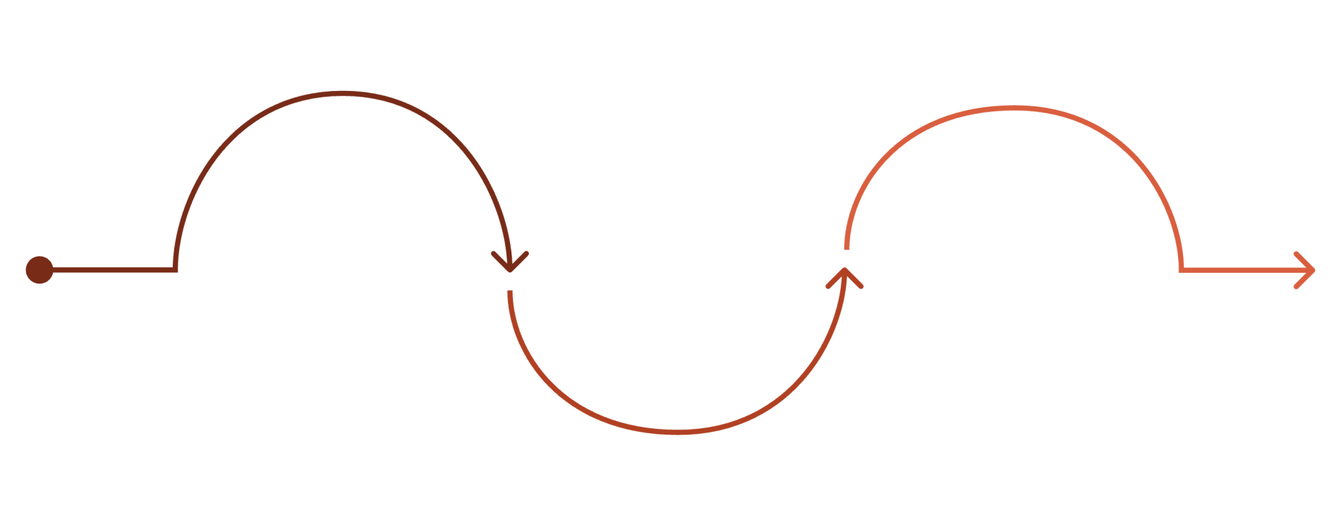
Brute Force vs. Hashing vs. Rabin–Karp
Brute Force
Direct character comparison at every possible
position.
✔ Simple and easy to implement.
✔ No preprocessing required.
✘ May perform repeated comparisons.
✘ Can become slow for large texts.
Basic Hash-Based Matching
Uses hash values as an initial filter before character
comparison.
✔ Demonstrates the idea of hashing in pattern matching.
✔ Can reject non-matches quickly.
✘ Requires verification when hashes match.
Rabin–Karp
Controlled hashing + rolling hash + verification.
✔ Efficiently updates window hash as window moves.
✔ Can find multiple occurrences.
✔ Practically efficient for large texts.
✘ Still O(n×m) in the worst case (many collisions).
Direct Comparison
Brute force character-
by-character checks
Rolling Hash (Rabin-Karp)
Efficient sliding hash with verification
Hash-Based Filtering
Use simple hashes to skip unlikely matches

Slide 48
Classroom Demo 1: Sequential Search
PART 8: CLASSROOM DEMONSTRATIONS
Question for Students Answer
4
4 comparisons are required.
The element 50 is never checked because the search stops immediately
after finding 40.
This is an example of a search that requires fewer than the worst-case n comparisons.
List = [10, 20, 30, 40, 50] Target = 40
How many comparisons are required to find 40?
Step-by-Step Answer
Step | Element | Result
1 | 10 | 10 ≠ 40 → Continue
2 | 20 | 20 ≠ 40 → Continue
3 | 30 | 30 ≠ 40 → Continue
4 | 40 | 40 = 40 → Found! ✓

Slide 49
Classroom Demo 2: Brute-Force String Matching
Task: Manually perform brute-force matching
Text: BANANA Pattern: ANA
Students should manually align the pattern at every possible position, compare the characters, and identify every occurrence.
Position | Alignment | Comparison | Result
i = 0 | BAN vs ANA | B ≠ A | No Match
i = 1 | ANA vs ANA | A=A✓ N=N✓ A=A✓ | Match ✓
i = 2 | NAN vs ANA | N ≠ A | No Match
i = 3 | ANA vs ANA | A=A✓ N=N✓ A=A✓ | Match ✓
Where is the first match? → Index 1
Where is the second match? → Index 3
How many times does the pattern occur? → Twice
Answer: Pattern ANA is found at positions [1, 3]. The pattern occurs twice in the text BANANA.

Slide 50

Classroom Demo 3: Hashing and Pattern Matching
Use this slide to encourage classroom discussion about the role of hashing in string matching.
Question 1
If the hash value of a text window is different from the hash value of the pattern, do we need to compare all characters?
Question 2
If the hash values are equal, can we immediately declare a successful match?
Question 3
Why is rolling hash important for Rabin–Karp's efficiency?
Answer: Rolling hash allows the window hash to be updated in O(1) time as the window slides. Without it, we'd need O(m) time to recalculate the full hash for each new window, making the algorithm no better than brute force in practice.
Answer: No. We should verify the actual characters because of possible hash collisions — two different strings can theoretically produce the same hash value. A hash match is a necessary but not sufficient condition for a string match.
Answer: No. If the hash values are different, the strings cannot be identical (for a deterministic hash function). The window can be rejected immediately without any character comparison. This is the key efficiency benefit of hashing.

Slide 51
Complete Conceptual Journey
PART 9: FINAL SUMMARY
Searching for an Element
Sequential Search
1
Searching for a Sequence
String Matching → Text and Pattern
2
Direct Comparison
Brute-Force String Matching → Searching a Word in a Document
3
Numerical Filtering
Introduction to Hashing → Hashing for Pattern Matching
4
Intelligent Pattern Search
Rabin–Karp → Rolling Hash → Hash Collision and Verification
5

Slide 52

Key Takeaways
Sequential Search
Searches for one element by checking elements one at a time. Best: O(1), Worst: O(n).
String Matching
Searches for a sequence of characters (pattern) inside a larger text. A match requires all characters to appear consecutively and in order.
Brute-Force String Matching
Checks the pattern at every possible position using direct character comparison. Simple but O(n × m) worst case.
Hashing
Converts data into numerical hash values. Can help filter possible matches
— different hashes mean definitely different strings.
Rabin–Karp
Uses hashing, window comparison, rolling hash for efficient update, and character verification to perform correct pattern matching.
The progression from Sequential Search to Rabin–Karp demonstrates how algorithm design can improve a simple searching approach by reducing unnecessary work.

Slide 53
Final Discussion Questions
1
Why can brute-force string matching become inefficient for a large document?
Because it may check O(n × m) character comparisons in the worst case, repeating work from previous mismatches and performing comparisons that could be avoided.
2
How does hashing help reduce unnecessary comparisons?
A single hash comparison can definitively reject a window if hashes differ, avoiding all m character comparisons for that window.
3
Why must characters still be verified after hash values match?
Because hash collisions can occur — two different strings may produce the same hash. Verification confirms the actual match.
4
What is the role of rolling hash in Rabin–Karp?
Rolling hash enables O(1) hash update when the window slides, making it efficient to process each new window position.
5
How can string-matching algorithms be used in search engines?
Search engines use pattern matching to locate keywords in billions of web pages, ranking documents by relevance.
6
How can pattern matching be useful in cybersecurity and bioinformatics?
In cybersecurity: detecting malicious signatures in files. In bioinformatics: finding gene sequences or protein patterns in long DNA strings.

Slide 54
Thank You
From Simple Searching to Intelligent Pattern Matching
The central idea of algorithm design is to reduce unnecessary work while
still producing correct results.
Next Learning Step
Advanced String Matching and the Knuth–Morris–Pratt (KMP) Algorithm
KMP eliminates repeated comparisons by using information about the pattern itself to intelligently skip positions after a mismatch.
Course: Design and Analysis of Algorithms

